Slide 1
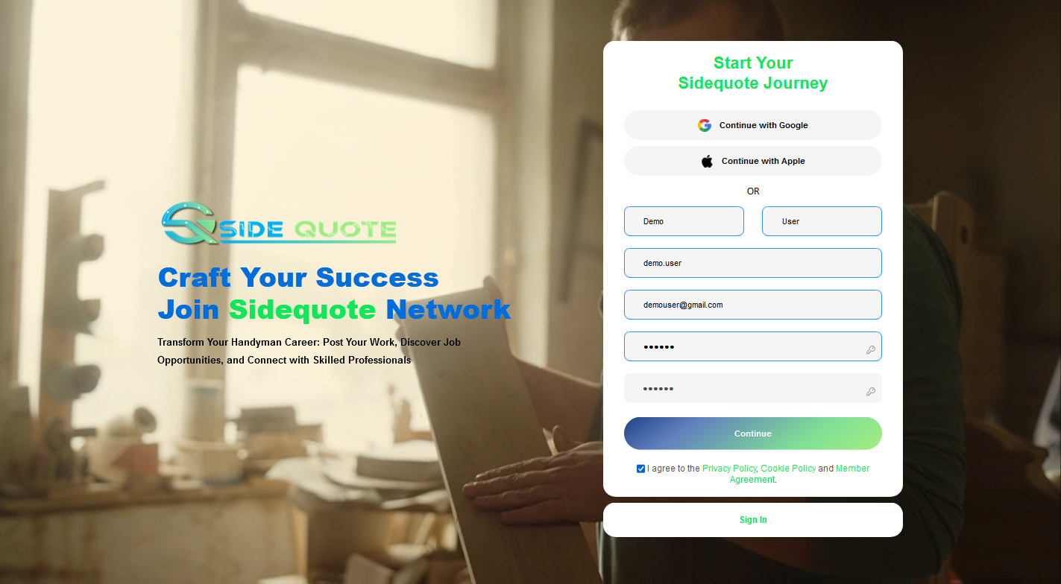
Registration Page:

Slide 2

Complete Registration :

Slide 3
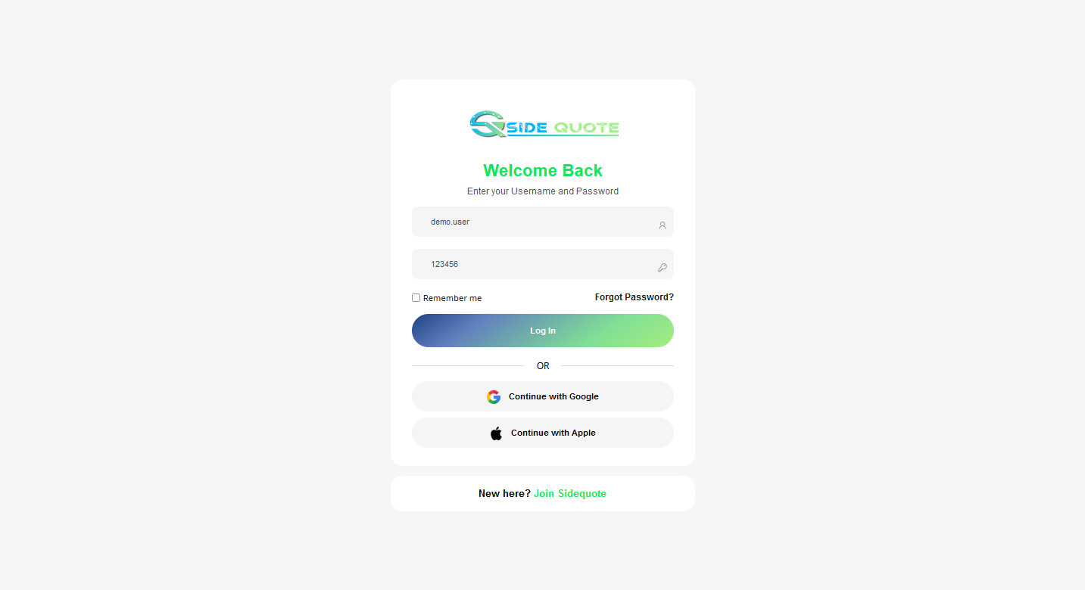
Login Page:

Slide 4
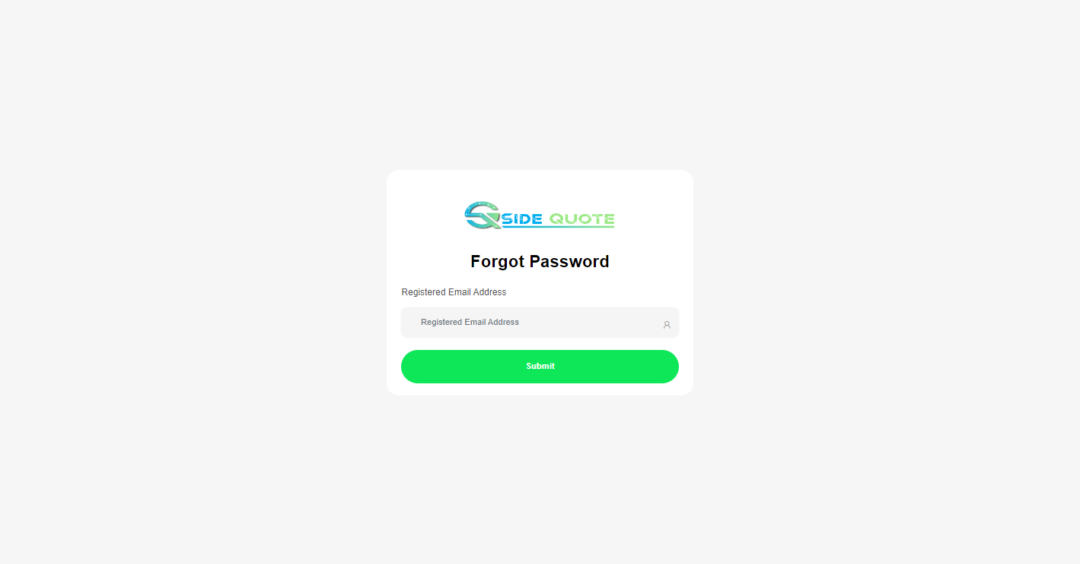
Forgot Password:

Slide 5
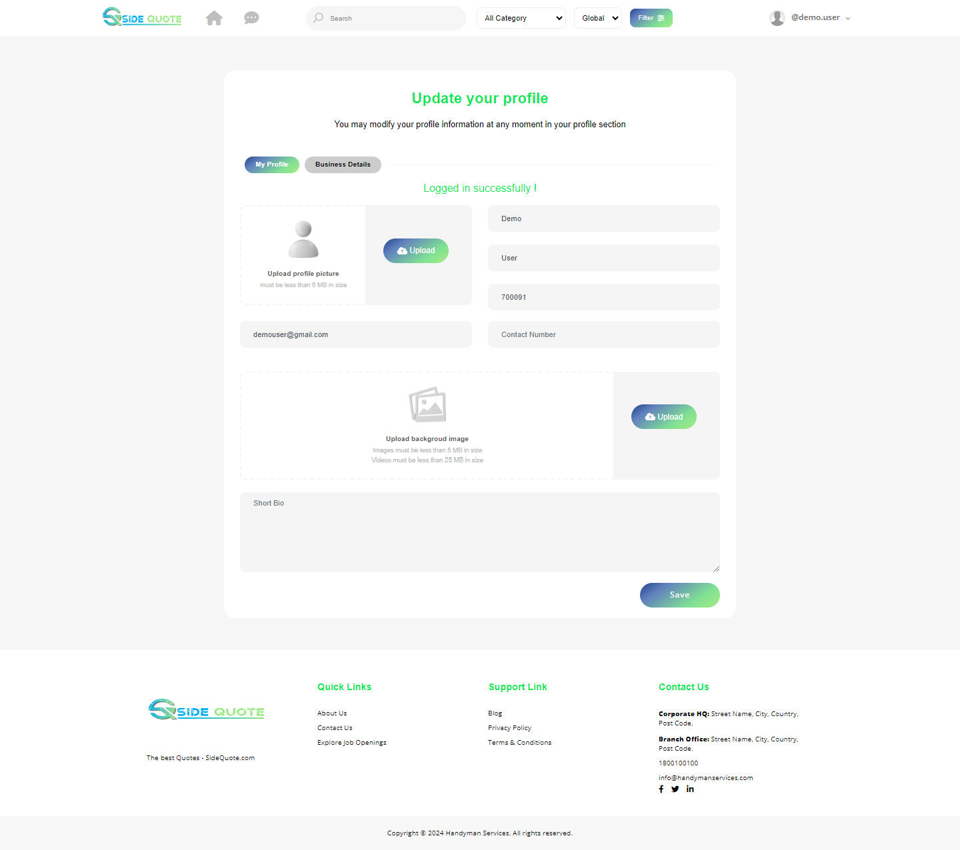
Home Page (Logged In update profile view):

Slide 6
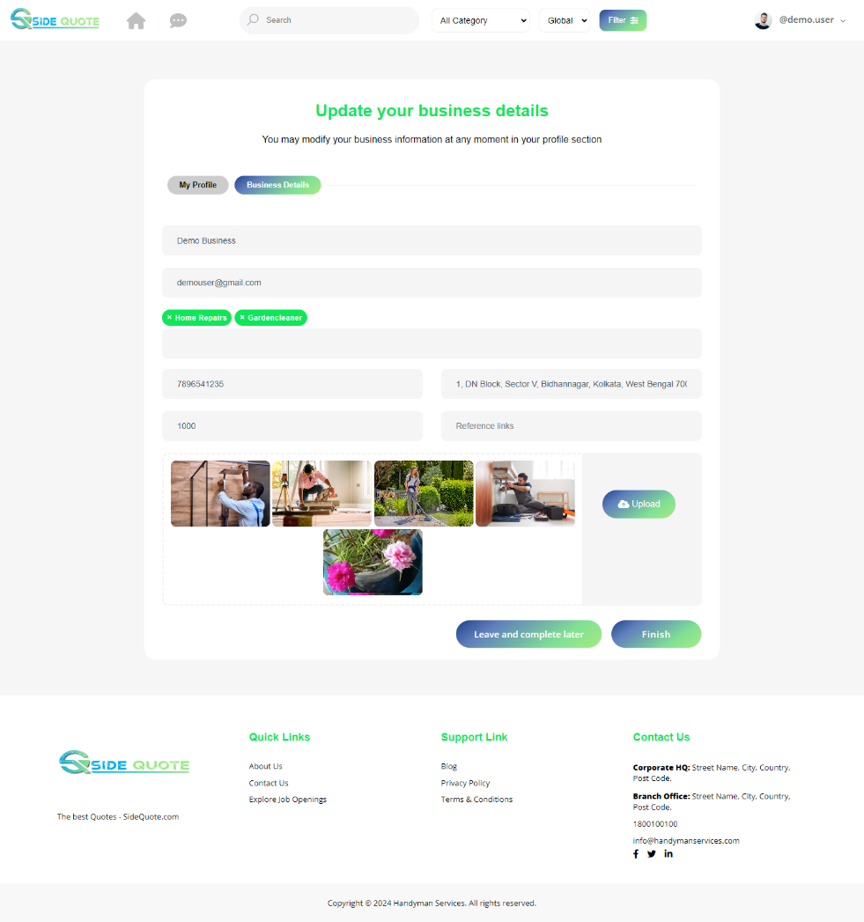
Home Page (Logged In update Business view):

Slide 7
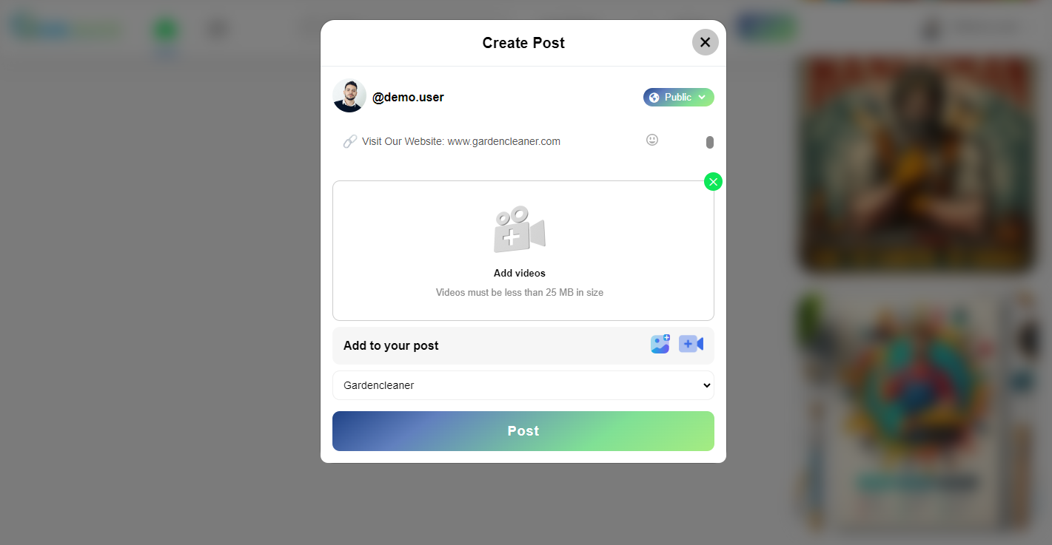
Post video Job:

Slide 8
Post image Job:

Slide 9
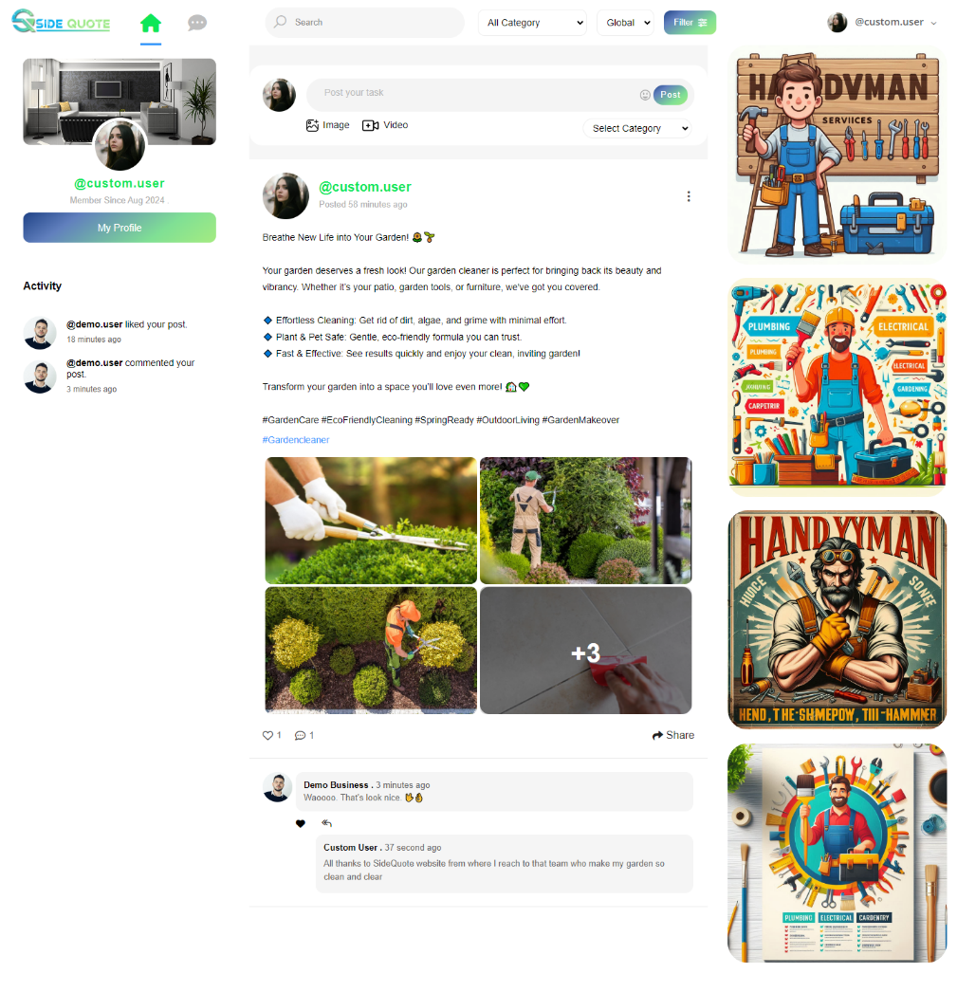
Home Page:

Slide 10
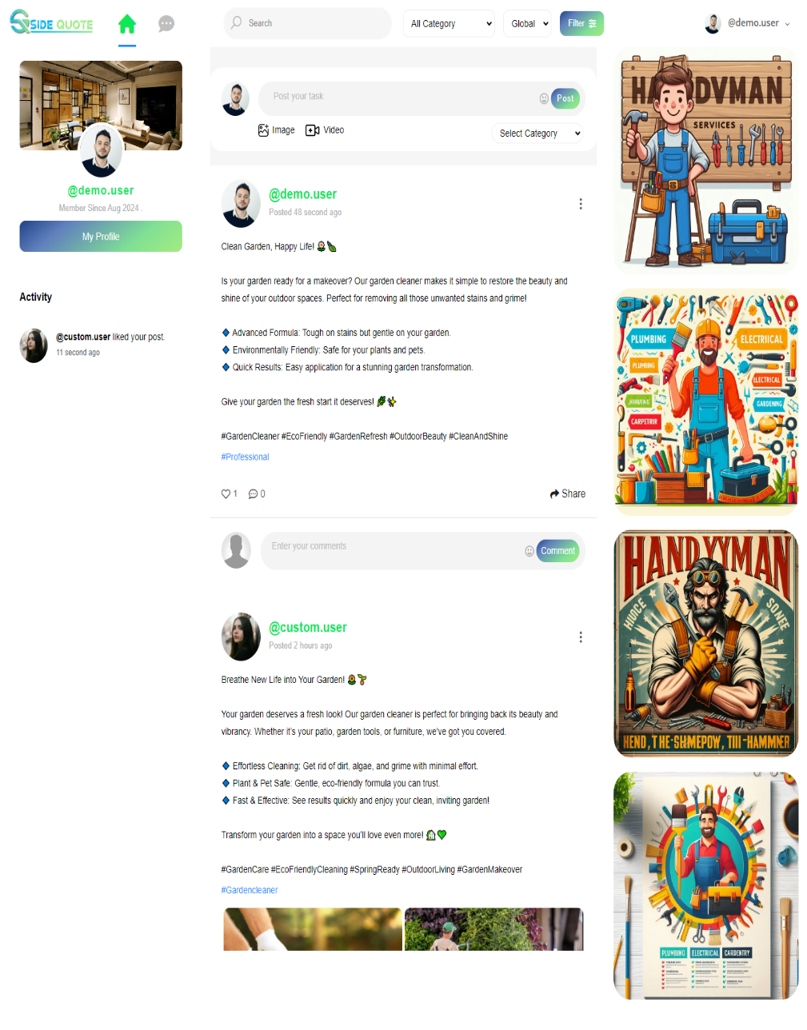
Post without Image:

Slide 11
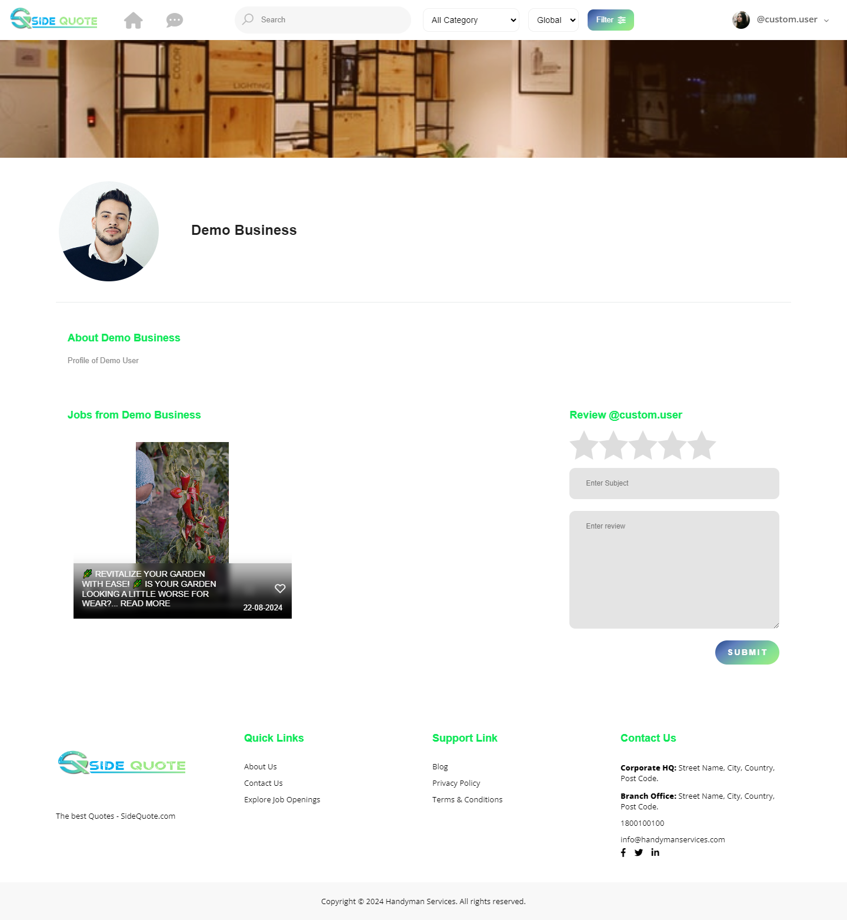
User Details Page:

Slide 12
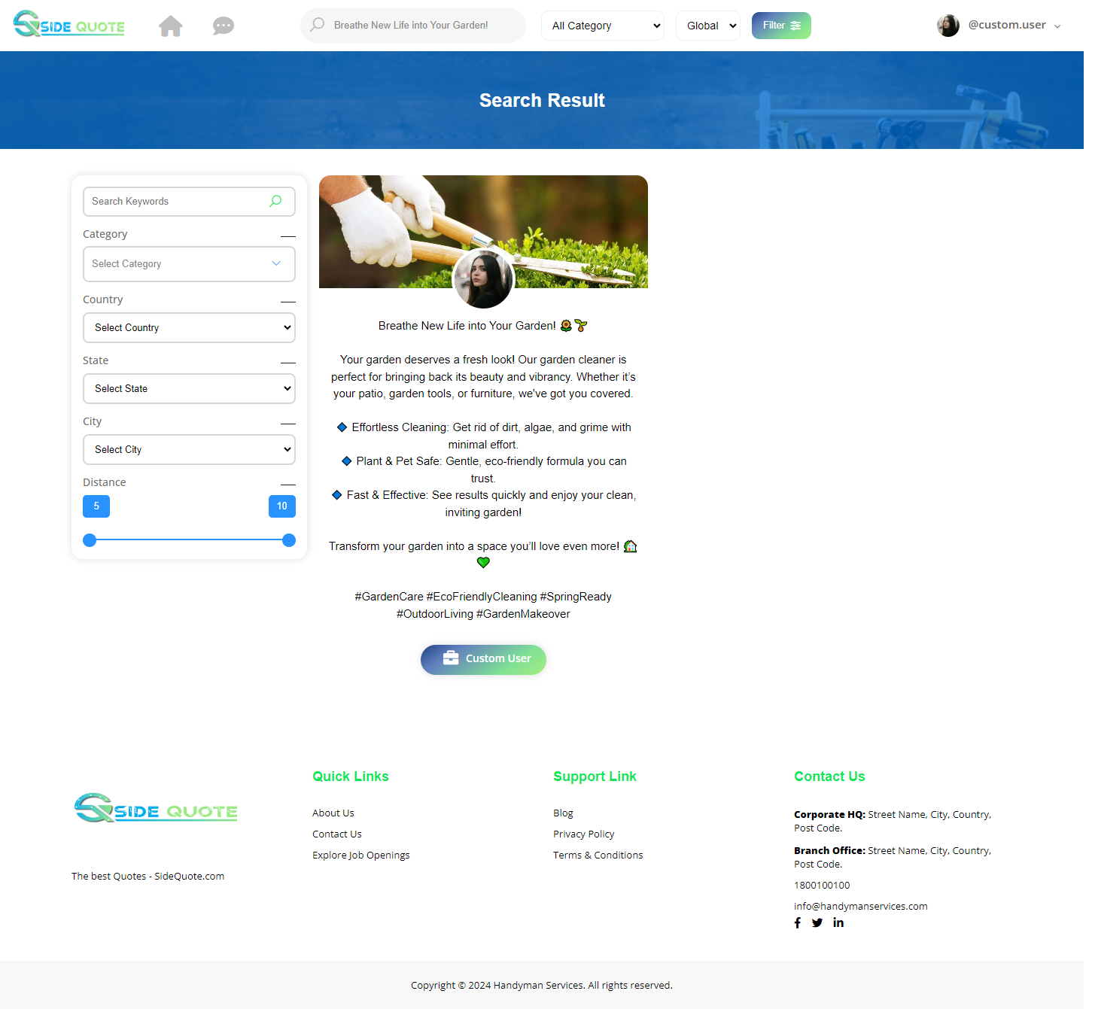
Search Post:

Slide 13
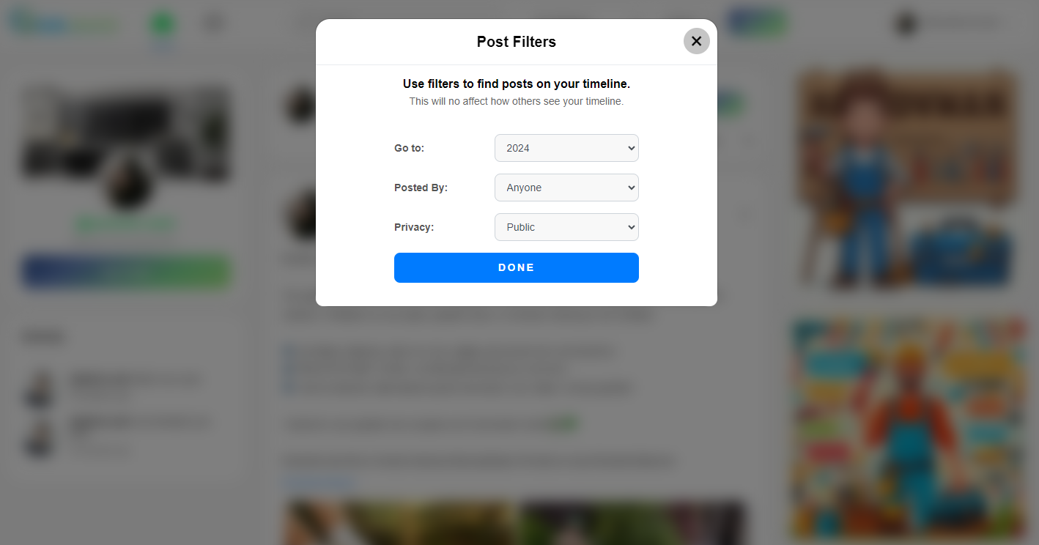
Filter Post:

Slide 14

Filter Post Data:

Slide 15
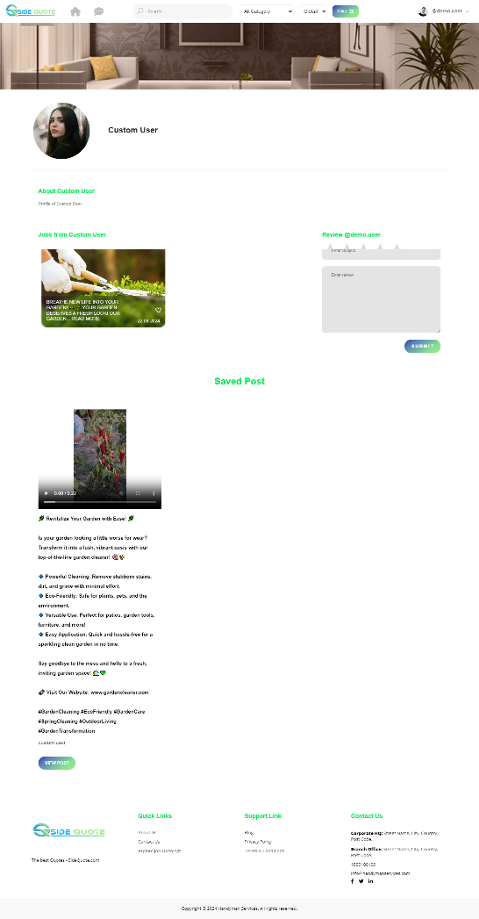
User profile with save post:

Slide 16
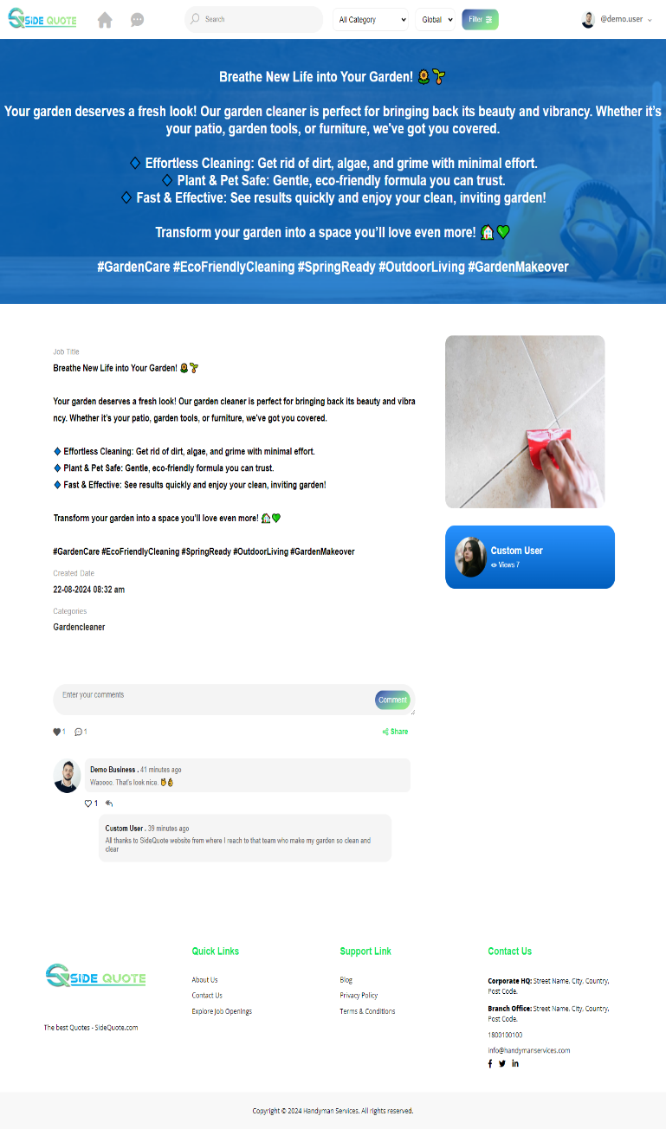
Post Details:

Slide 17
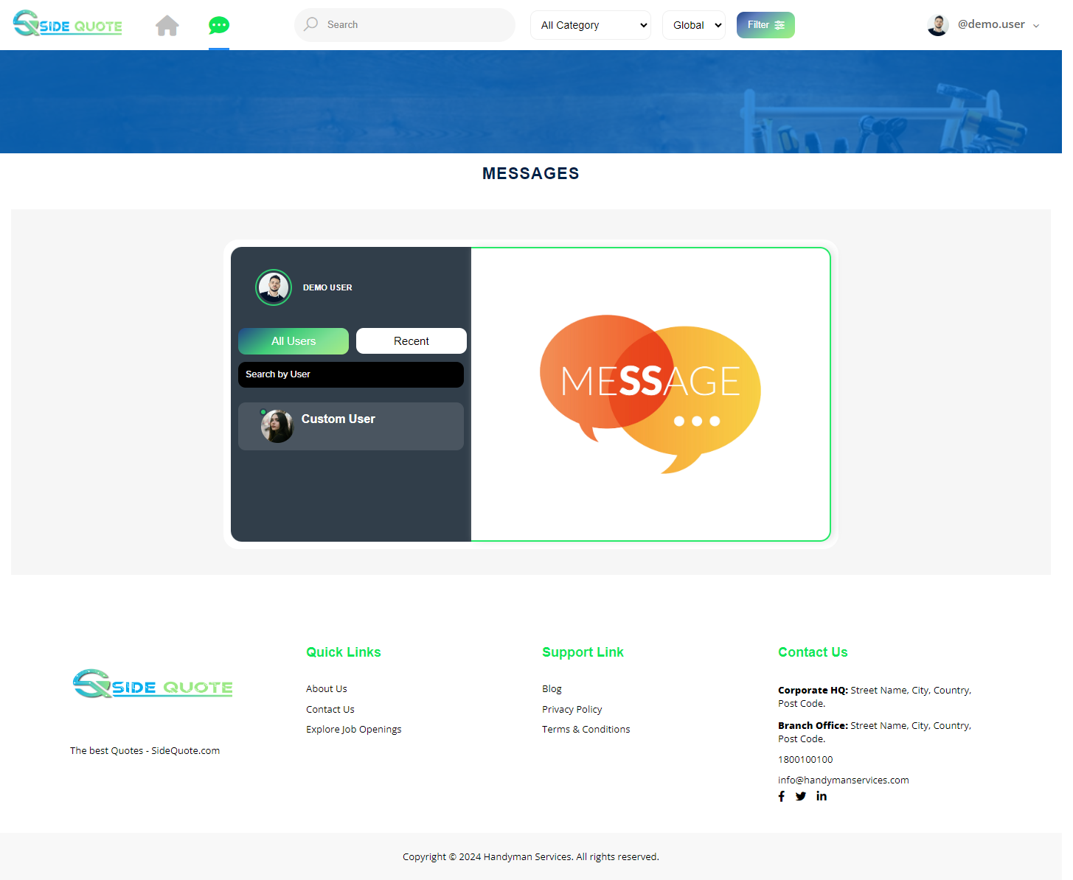
Chat List:

Slide 18
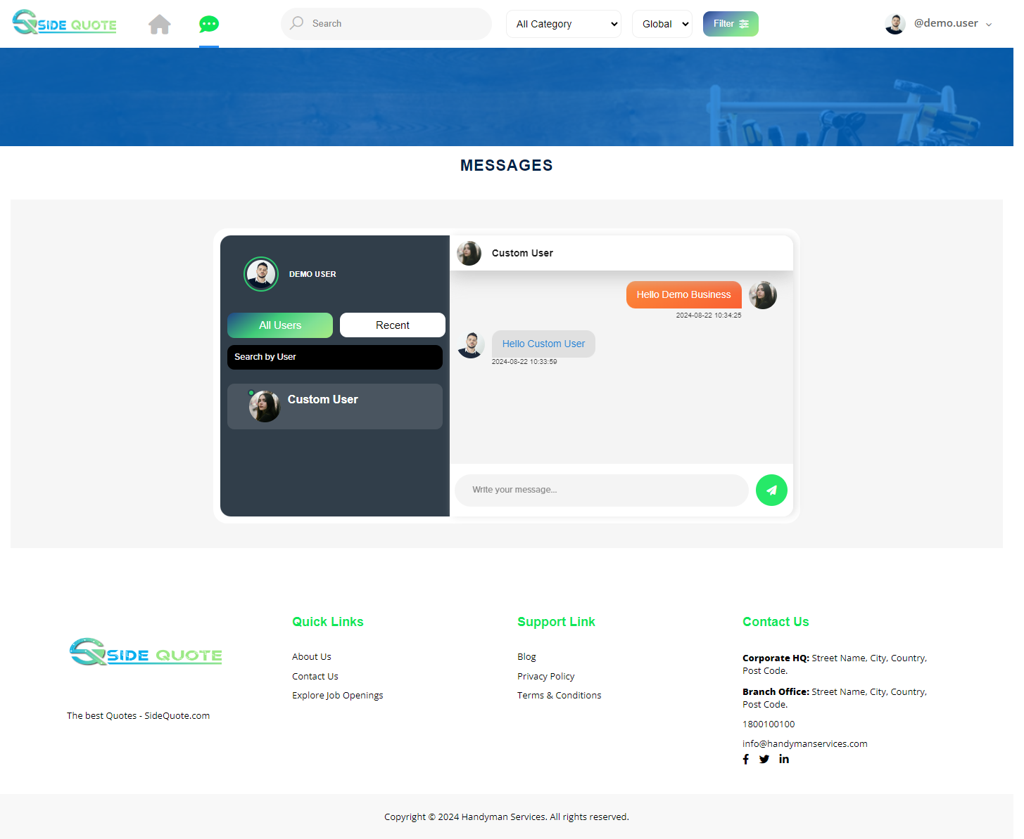
Chat with user:

Slide 19
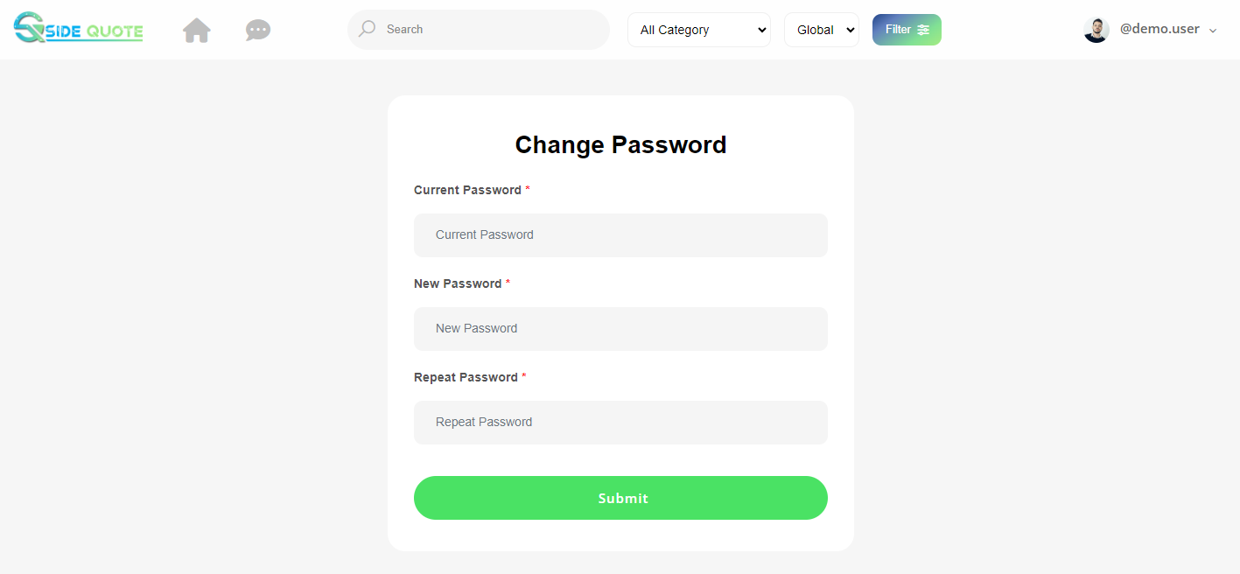
Change Password:

